Slide 1
Input Scanner
The most flexible and common way to read an input from a user is by asking them to type in something and wait till they respond.
This is done using a Java class called Scanner .
First, to be able to access this class, you have to point your program to the java.util library that includes the Scanner class. You do that by typing this at the very top of the file
import java.util.Scanner;
Scanner scanner = new Scanner(System.in);
int grade = scanner.nextInt();

Slide 2
File Scanner
To read a text file in Java you can also use the same Scanner class we used to read command line inputs, but instead of passing System.in as the argument you pass a File object which you can create by typing in the file name:
File file = new File("expenses.txt");
Scanner fileScanner = new Scanner(file);
while (fileScanner.hasNextLine()) {
String line = fileScanner.nextLine();
System.out.println(line);
}
fileScanner.close();

Slide 3
Catching exceptions
Inside the catch block you have the choice of either handling the situation quietly (like printing an error message or showing a warning popup)
try{
openFile("somefile.txt");
} catch(FileNotFoundException exception) {
// Handle the situation by letting the user know what happened
System.out.println("Cannot find that file");
}

Slide 4
List of OOP Concepts in Java
Abstraction. Abstraction means using simple things to represent complexity. We all know how to turn the TV on, but we don’t need to know how it works in order to enjoy it. In Java, abstraction means simple things like objects, classes, and variables represent more complex underlying code and data. This is important because it lets avoid repeating the same work multiple times.
Encapsulation. This is the practice of keeping fields within a class private, then providing access to them via public methods. It’s a protective barrier that keeps the data and code safe within the class itself. This way, we can re-use objects like code components or variables without allowing open access to the data system-wide.
Inheritance. This is a special feature of Object Oriented Programming in Java. It lets programmers create new classes that share some of the attributes of existing classes. This lets us build on previous work without reinventing the wheel.
Polymorphism. This Java OOP concept lets programmers use the same word to mean different things in different contexts. One form of polymorphism in Java is method overloading. That’s when different meanings are implied by the code itself. The other form is method overriding. That’s when the different meanings are implied by the values of the supplied variables. See more on this below.

Slide 5
Inheritance
Inheritance can be defined as the process where one class acquires the properties (methods and fields) of another. With the use of inheritance the information is made manageable in a hierarchical order.
class Animal {
}
class Mammal extends Animal {
}
class Reptile extends Animal {
}

Slide 6
Polymorphism
Polymorphism is the ability of an object to take on many forms. The most common use of polymorphism in OOP occurs when a parent class reference is used to refer to a child class object.
public interface Vegetarian{}
public class Animal{}
public class Horse extends Animal implements Vegetarian{}
A Horse IS-A Animal
A Horse IS-A Vegetarian
A Horse IS-A Deer
A Horse IS-A Object

Slide 7
Guess the number game
In this example, we will get to use the input scanner to build a guessing game where the computer will generate a random number between 1-100, and the user gets 10 guesses to find out what that number is.
When the game first starts it prints a few sentences explaining what's going on:

Slide 8
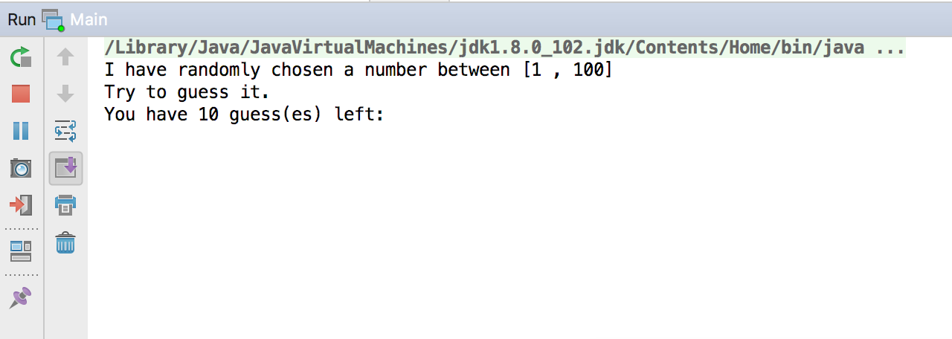

Slide 9
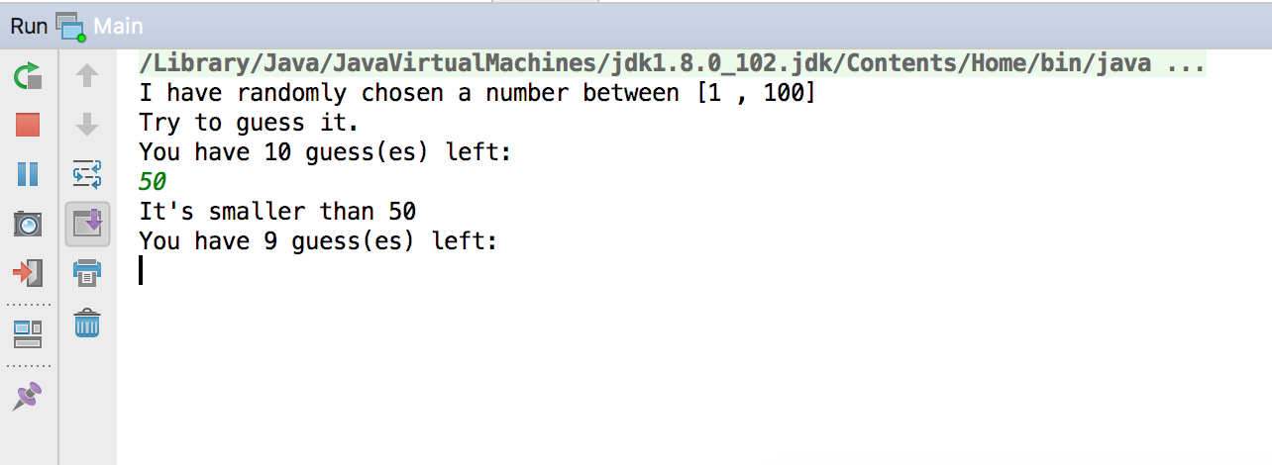
Then asks the user to guess the number. Once the user types in a number and hits enter, the game will compare that guessed number with the random number it had generated and tell the user if it's smaller or larger, then they get to guess again.

Slide 10
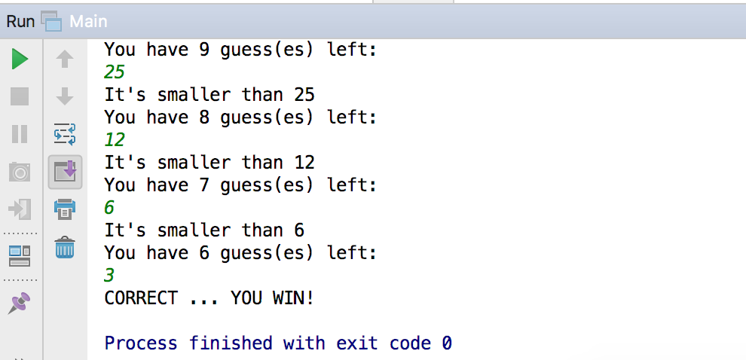
If the user manages to guess the number before they run out of guesses they win. Otherwise they lose!

